Slide 1
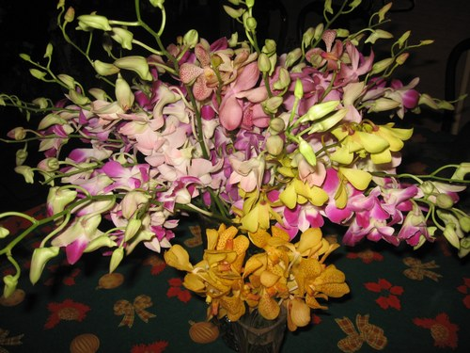

Slide 2
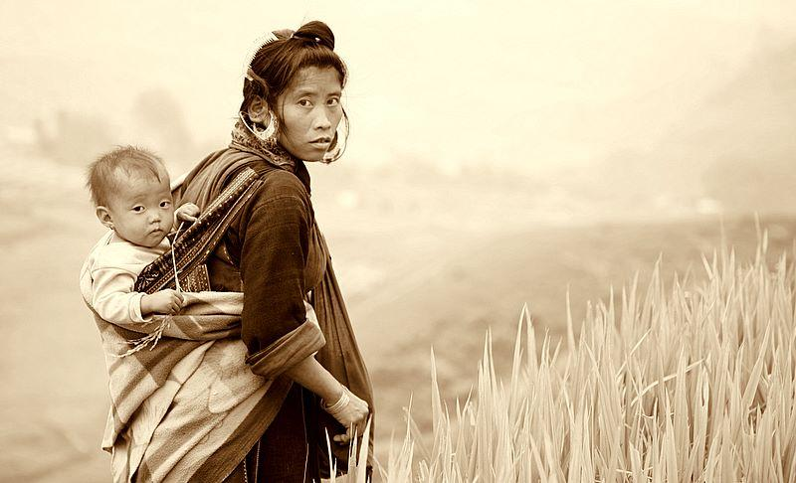
To Be A Woman

Slide 3
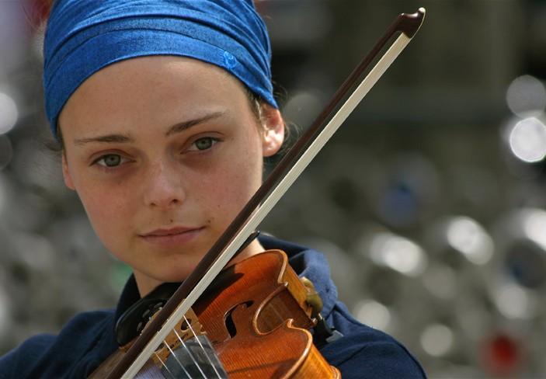
A recognition of women of all ages and nationalities, and especially those who, against all odds, persevere in loving, dreaming, and battling for a better world. The theme music is by Vengelis, a Greek composer, and is entitled “Glorianna – Hymn To Women

Slide 4


Slide 5
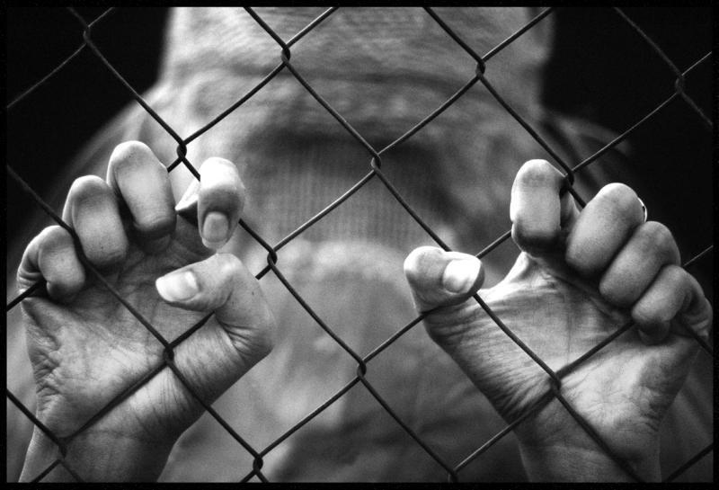

Slide 6
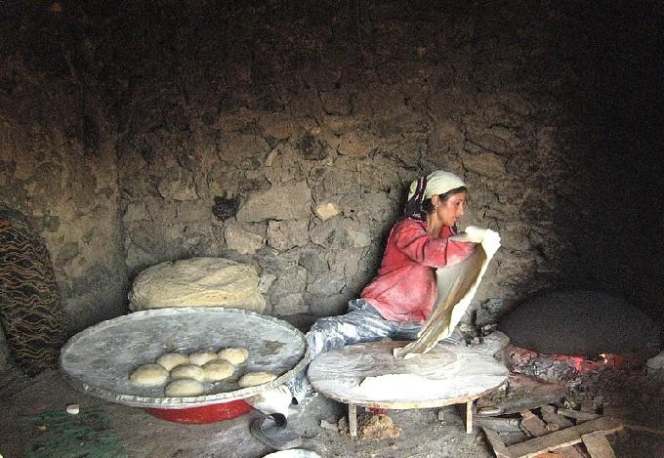

Slide 7
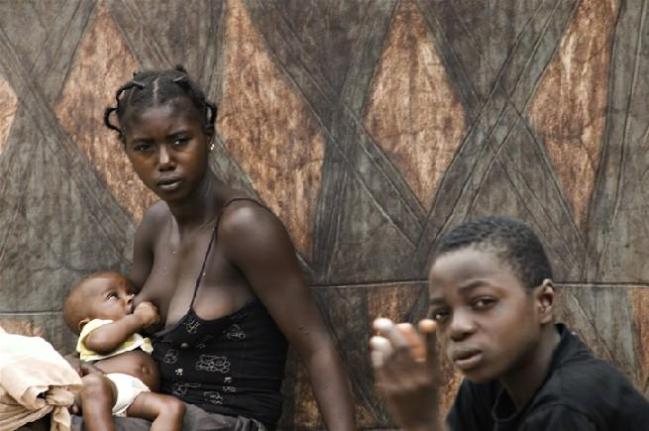

Slide 8
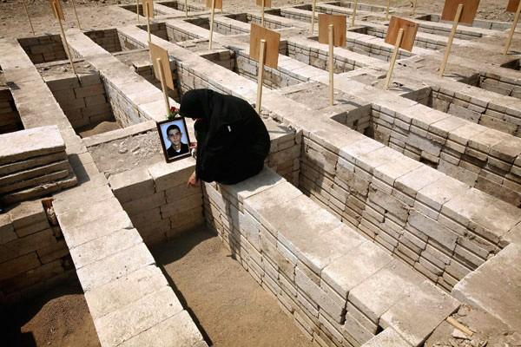

Slide 9
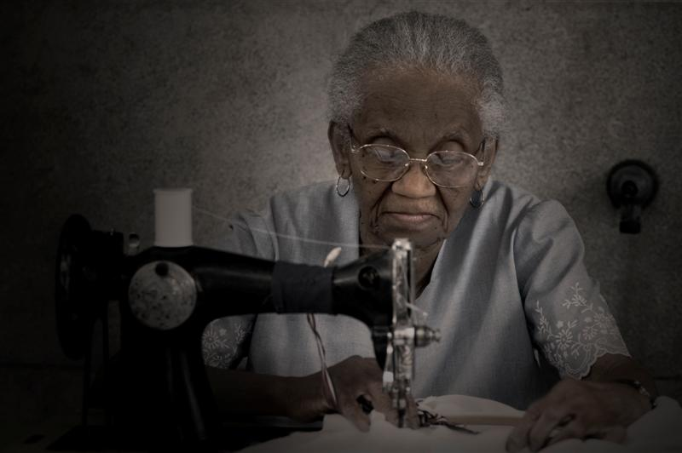

Slide 10
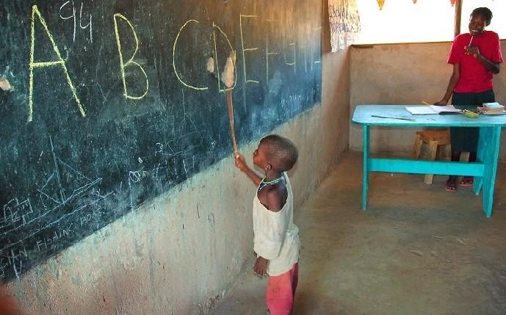

Slide 11
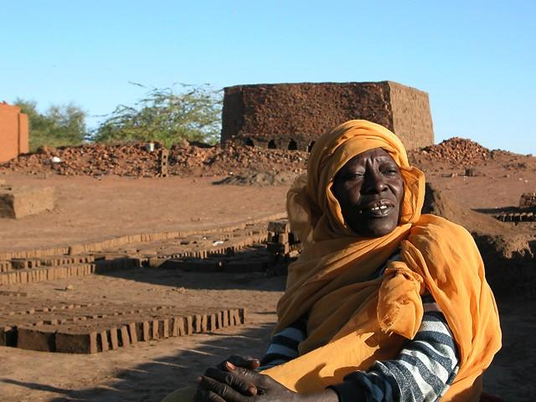

Slide 12
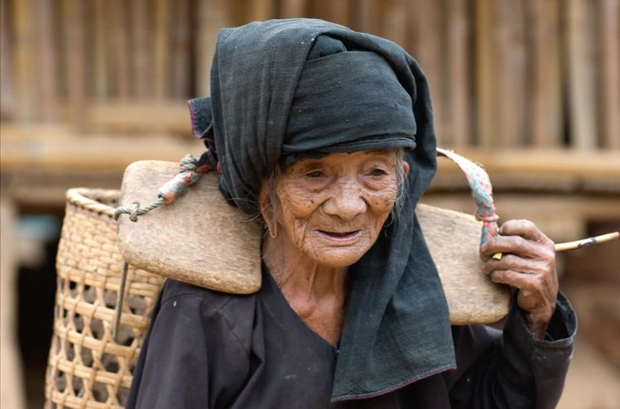

Slide 13
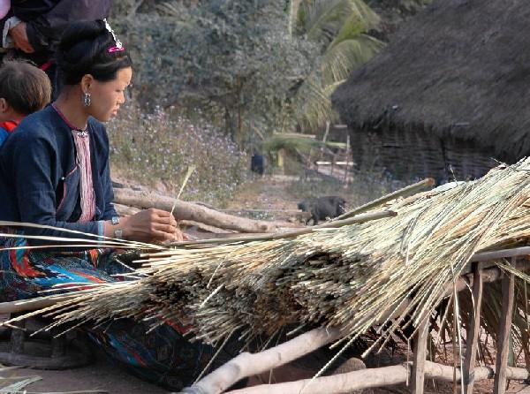

Slide 14
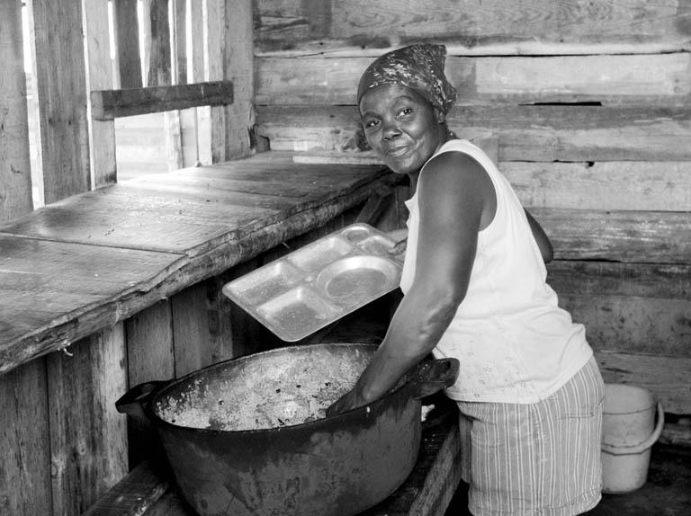

Slide 15


Slide 16
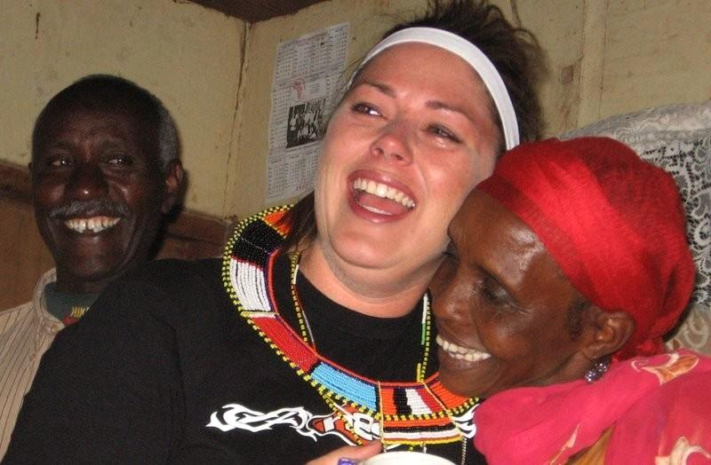

Slide 17


Slide 18


Slide 19
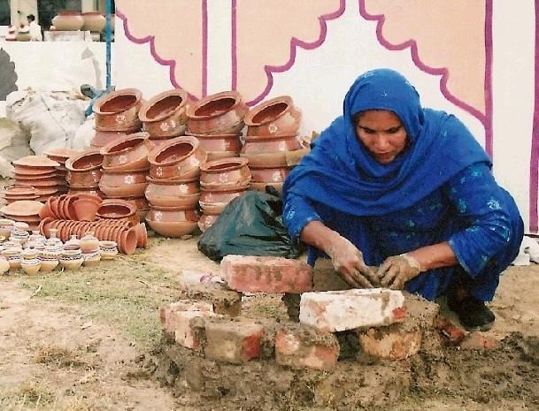

Slide 20
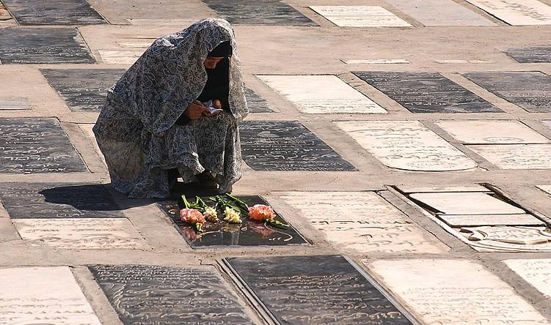

Slide 21
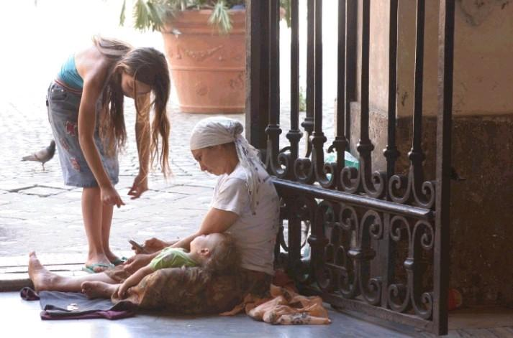

Slide 22
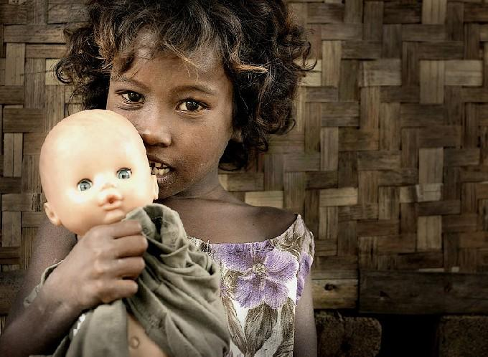

Slide 23
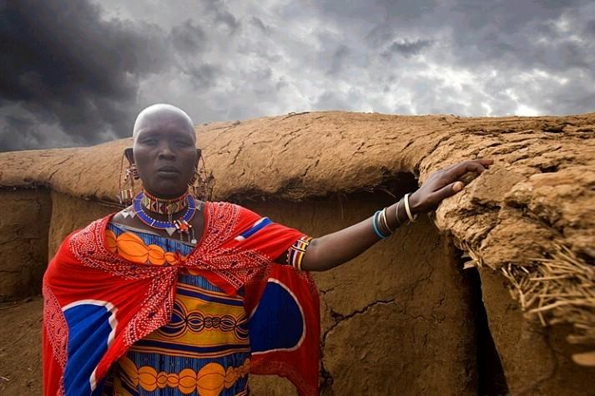

Slide 24
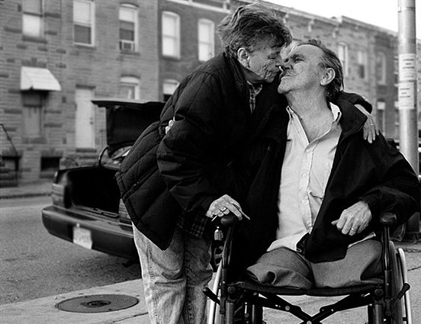

Slide 25
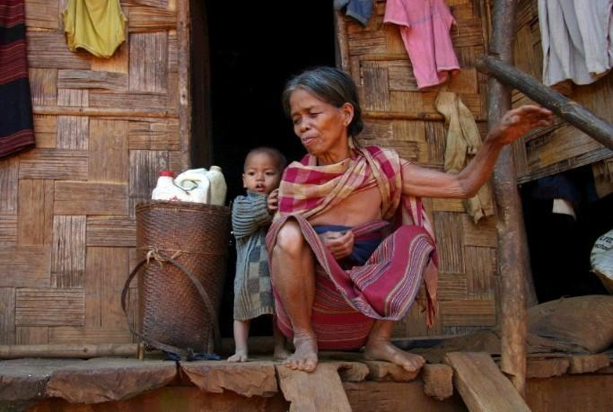

Slide 26


Slide 27
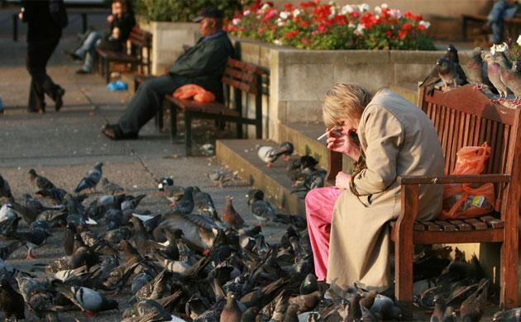

Slide 28
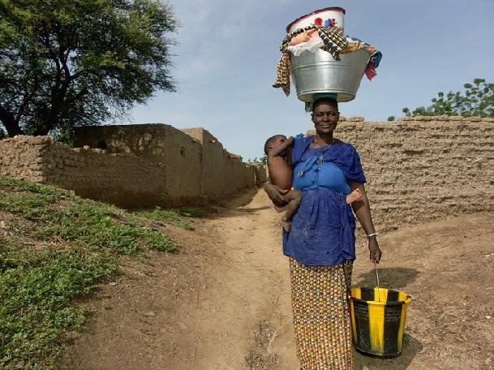

Slide 29
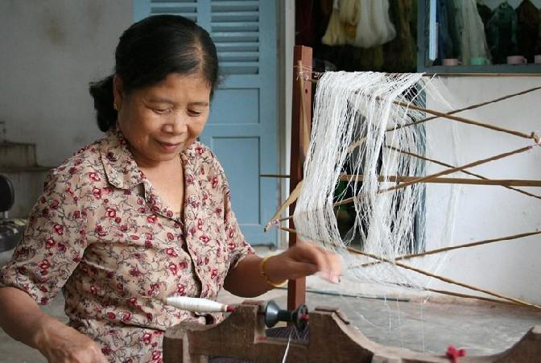

Slide 30
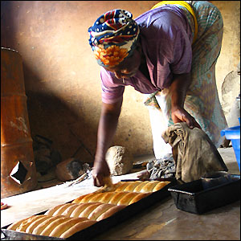

Slide 31
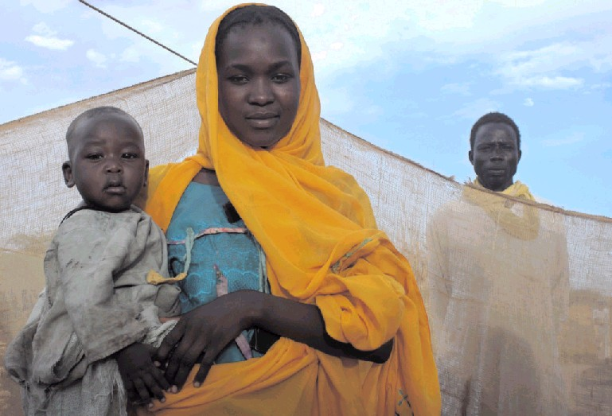

Slide 32
Women have energy that amazes men.
They meet difficulties and manage serious problems, while remaining cheerful, loving, and joyous.
They smile when they want to cry out, sing when they want to shed tears, cry when they are happy, and laugh when they are nervous.

Slide 33
They battle for what they believe in.
They rebel against injustice.
They do not accept "no" for an answer when they think there is a better solution.
They deny themselves to keep the family sustained.
They go to the doctor with an anxious friend.
They love unconditionally.

Slide 34
They cry when their children achieve success
and they rejoice at the good fortune of their friends.
They are happy when they hear talk of a birth or a marriage.

Slide 35
Their hearts are bruised when a friend dies.
They suffer from the loss of a dear person.
They are strong when they think they have no more energy.
They know that a hug and a kiss can heal a wounded heart.

Slide 36

There is no doubt that a woman has a defect...
It is that she forgets what she is worth.

Slide 37

Send this to your woman friends to remember what wonderful creatures they are.
And send it also to men, because sometimes they need to remember these facts.

